Slide 1

MBEYA UNIVERSITY OF SCIENCE AND TECHNOLOGY
COLLEGE OF INFORMATION AND COMMUNICATION
TECHNOLOGY
DEPARTMENT OF ELECTRONICS AND TELECOMMUNICATION
ENGINEERING
TITLE: EXPLAINABLE AI FOR PULMONARY EDEMA DETECTION IN CHEST X-RAY IMAGES
Student Name: BONIFACE BEN SANKWA
Registration number: 22100934340091
Supervisor: Dr. NYATEGA

Slide 2
Background Information
Pulmonary edema is caused by fluid accumulation in the lungs.
It affects breathing and oxygen exchange.
Chest X-rays are commonly used for lung diagnosis.
Manual interpretation is challenging and error-prone.
Deep learning offers automated and accurate detection.
Challenge: AI models often act as “black-boxes”

Slide 3
Problem Statement
Diagnosis depends on skilled radiologists.
Many hospitals lack enough specialists.
Pulmonary edema looks similar to pneumonia.
Manual diagnosis may lead to delays and errors.
Deep learning models lack explainability
Doctors struggle to trust AI predictions

Slide 4
Main Objective
To develop an Explainable AI system for detecting pulmonary edema in chest X-ray images, capable of providing diagnostic results along with visual explanations of the regions used for prediction.

Slide 5
Specific Objectives
Study pulmonary edema features in X-ray images.
Collect and preprocess chest X-ray datasets.
Train a CNN model for detection.
Apply Explainable AI techniques.
Evaluate model performance.
Develop a simple web interface to display predictions and heatmaps.

Slide 6
Literature Review
Purpose of Literature Review
To examine existing knowledge, theories, and systems related to pulmonary edema detection in chest X-ray images.
Pulmonary Edema Context
A life-threatening condition often linked to heart failure, requiring timely and accurate diagnosis.
Chest X-Ray Challenges
X-rays are affordable and widely available, but interpretation is complex and prone to human error.
Deep Learning Contribution
CNNs have shown strong performance in medical imaging, automating disease detection with high accuracy.
Explainable AI Importance
Techniques such as Grad-CAM provide transparency, helping clinicians understand and trust AI predictions.

Slide 7
Related Works
CNN-based Systems
Deep learning models such as ResNet, DenseNet, and VGG have been widely applied in chest X-ray analysis. Abbasi et al. 2025) used ensemble CNNs for pulmonary edema detection, achieving high accuracy but without explainability.
Global Datasets (CheXpert & ChestX-ray14)
Irvin et al. (2019) introduced the CheXpert dataset covering multiple thoracic diseases, including pulmonary edema. Rajpurkar et al. (2017) developed CheXNet for pneumonia detection, showing radiologist-level accuracy but functioning as a “black-box.”
❖ Explainable AI Approaches
Danilov et al. (2024) applied Grad-CAM to provide visual explanations of CNN predictions, improving clinical trust. Tjoa & Guan (2020) emphasized the importance of transparency and interpretability in healthcare AI systems.

Slide 8
Research Gap
Pulmonary edema detection underexplored.
Lack of explainability in existing systems.
Minimal clinical adoption due to lack of transparency.
Therefore, there is a need for a CNN-based system integrated with Explainable AI (Grad-CAM) to enhance transparency and clinical trust.

Slide 9
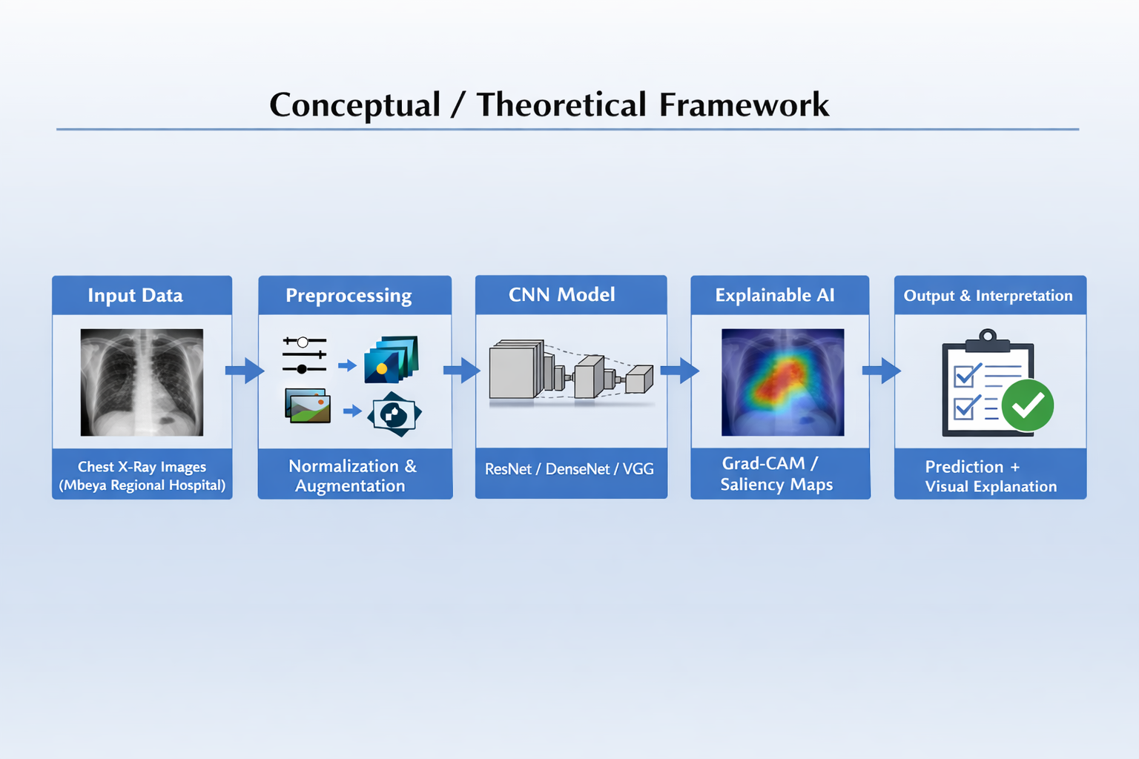
Conceptual/Theoretical Framework

Slide 10
References
Abbasi, M., et al. (2025). Enhanced detection of pulmonary edema in chest X-rays using deep learning ensembles with attention mechanism. Journal of Imaging Informatics in Medicine.
Danilov, A., et al. (2024). Explainable AI to identify radiographic features of pulmonary edema. Radiology Advances.
Rajpurkar, P., Irvin, J., Zhu, K., Yang, B., Mehta, H., Duan, T., ... & Ng, A. Y. (2017). CheXNet: Radiologist-level pneumonia detection on chest X-rays with deep learning.
Irvin, J., Rajpurkar, P., Ko, M., Yu, Y., Ciurea-Ilcus, S., Chute, C., ... & Ng, A. Y. (2019). CheXpert: A large chest radiograph dataset with uncertainty labels and expert comparison. Proceedings of the AAAI Conference on Artificial Intelligence, 33(01), 590–597.
Tjoa, E., & Guan, C. (2020). A survey on explainable artificial intelligence (XAI): Toward medical XAI. IEEE Transactions on Neural Networks and Learning Systems, 32(11), 4793–4813.

Slide 11
THANK YOU

